Slide 1
Read video
By,
Akhilesh Gattu,
Latha Muddu

Slide 2
Introduction
The main idea behind the project is to find out the swimming styles in the given video.
This is shown on the UI for user in the form of text.
This is done by developing a model, Decision Tree using Spark MLLib.
This model is retrieved in storm and the video features are analyzed in order to classify the swimming style.

Slide 3
Tools and Technologies
Open IMAJ
Kafka
Spark (MLLib)
Storm
MongoDB

Slide 4
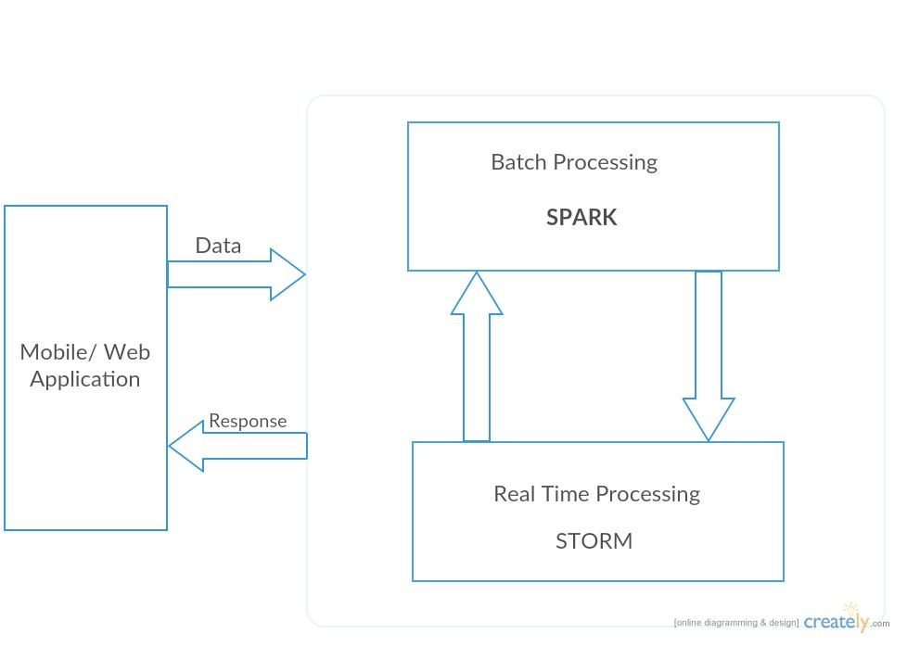
Architecture

Slide 5
Flow

Slide 6
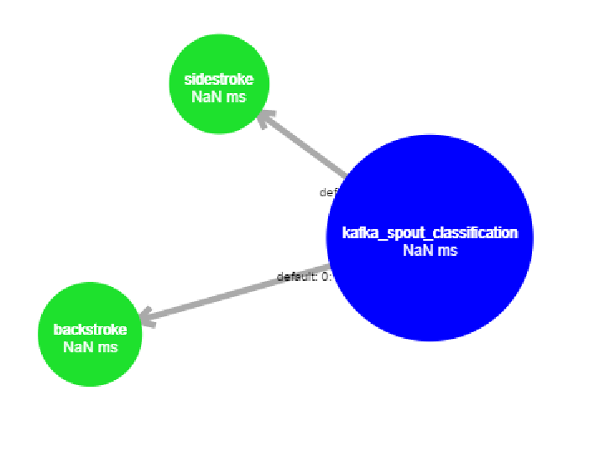
Topology

Slide 7
Future Scope
Event Detection
Winning Prediction

Slide 8


Slide 9


